Slide 1


Welcome to Xamarin.Forms
Jason Farrell
Xamarin Certified Developer
Microsoft MVP

Slide 2
Who am I?
Jason Farrell
West Monroe Partners Principal
I lead teams developing mobile applications
Xamarin
Objective-C
Android Java
Four years with Xamarin

Slide 3
Xamarin: In a nutshell
Each platform contains a unique UI
Shared Project and PCLs facilitate shared code between platforms
Enables fast parallel programming scenarios to support multiple platforms
iOS C# UI
Android C# UI
Windows C# UI
Shared C# Mobile

Slide 4
Xamarin Positives and Negatives
Enables a unified code base and language
Apps created utilize the same underlying tech as native
Not hybrids, these are full fledged native apps
Duplicate memory system – synchronization is difficult
Full ecosystem not available
UI must still be created uniquely for each platform

Slide 5
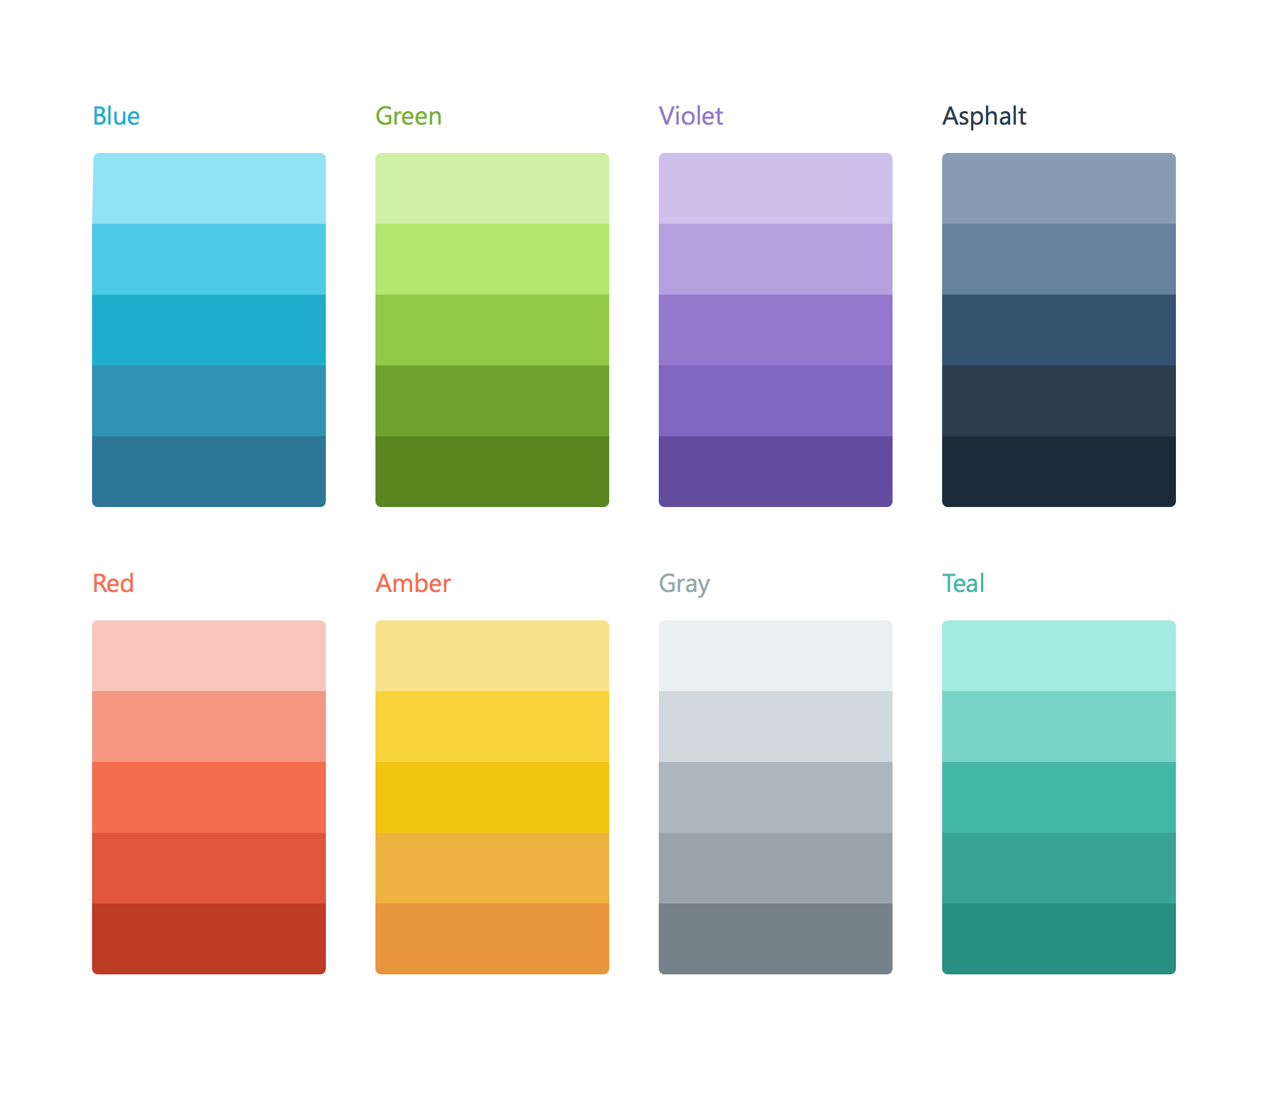
Xamarin.Forms
Shared UI layer defined in Xaml
Processed by renders
Output looks and feels native for each supported platform
Shared UI Code
Shared C# Backend
Write Once, Render Anywhere
With Xamarin.Forms: More code-sharing, all native

Slide 6
Haven’t we been here before?
One and never done?

Slide 7
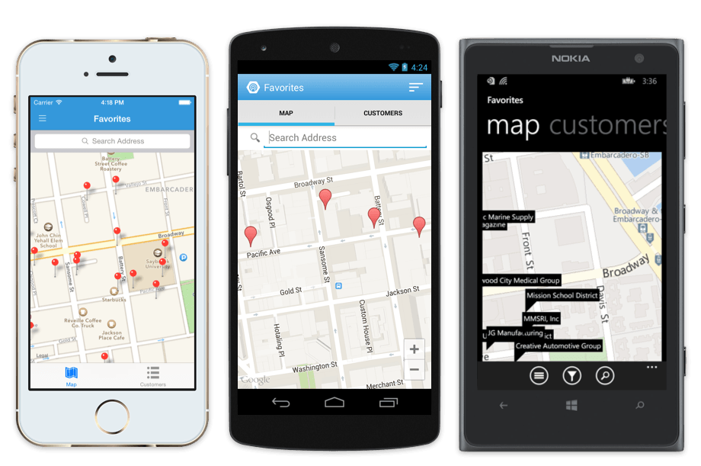
One Definition, Rendered Natively

Slide 8
Xamarin.Forms Requirements
Current Version: 2.2.x
Android 4.0.3 (API 15) or higher
iOS 6.1 or higher
Windows 10
Windows Phone 8.1

Slide 9
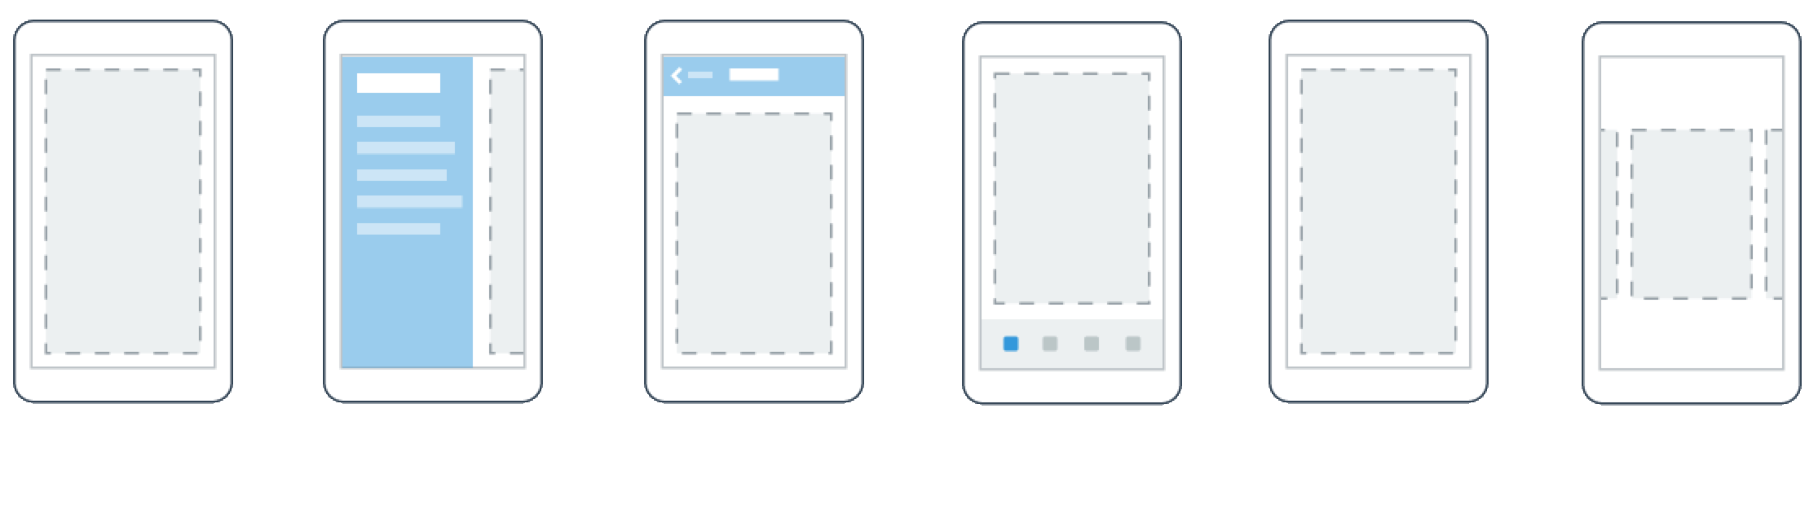
Pages

Slide 10
Navigation Page
Supports the navigation model for the platform
Allows for “push” navigation
Shows standard page title
Effect
Action Bar is shown (Android)
Navigation bar is shown (iOS)
Title bar is shown (UWP)

Slide 11
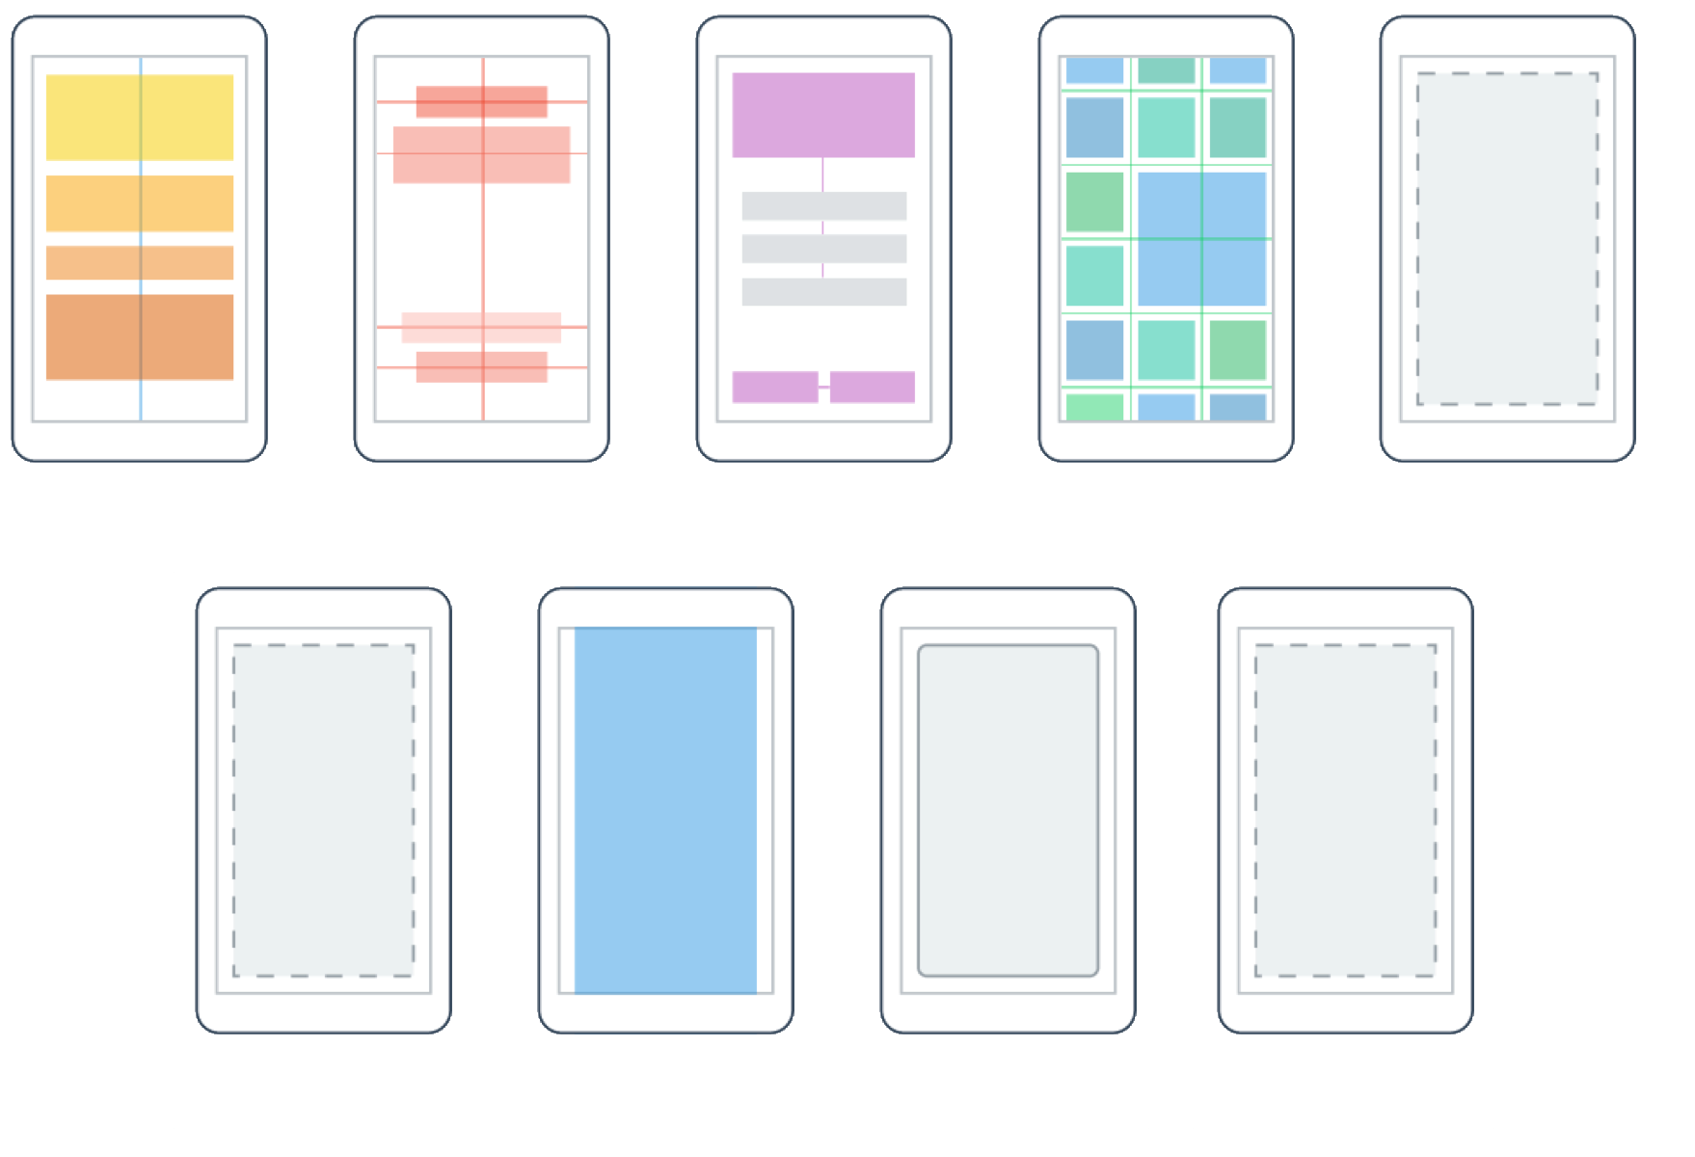
Layouts

Slide 12



Controls
ActivityIndicator
BoxView
Button
DatePicker
Editor
Entry
Image
Label
ListView
OpenGL View
Picker
ProgressBar
SearchBar
Slider
Stepper
Switch
TableView
TimePicker
WebView

Slide 13
Let’s build a simple app
Simple Color Picker

Slide 14
What is going on exactly?
App Window
XAML Definition is passed through rendering engine
Forms is NOT creating individual Activities or ViewControllers; it is replacing the root with a generated one
This is why NavigationPage is needed to support navigation
You are never actually leaving the one activity
Transplanted View
Rendering Engine
XAML/Code Definition

Slide 15
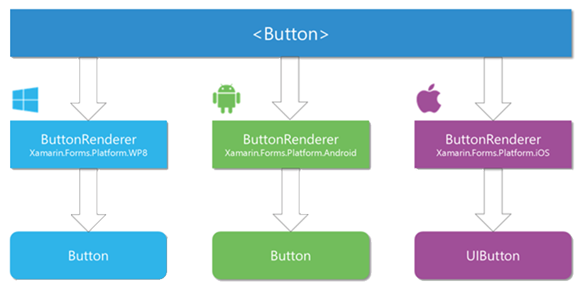
Control Rendering

Slide 16
Key Takeaways
Shared and PCL Core projects is supported
My preference is PCL (Shared projects are great with traditional)
Shared is a must to use Native Control embedding
Separate projects are created per platform
These act as bootstrappers and contain platform specific code
The majority of your work SHOULD be in the Core app
Forms Xaml shares many similarities with WPF Xaml
but its not the same

Slide 17
How can I customize the UI?
Platform Specific Controls (2.2+)
Custom Renderers
Custom Behaviors
Custom Effects

Slide 18
Demo
StarCraft Unit Lookup

Slide 19
When do I use Forms?
Data Entry apps
POCs
Apps that do not require heavy UI customization
Apps that do not heavily leverage platform specific feature
Bluetooth
GPS

Slide 20
Rule of Thumb
If you are doing a lot in traditional Xamarin, use traditional Xamarin

Slide 21
Other Platform Features
DependencyService
Allows for each IoC management without an external library
ServiceLocator focused
MessagingCenter
Provides a Simple Pub/Sub interface to allow for message based communication
Animations

Slide 22
Advanced Topics
Hybrid applications
Combining Traditional Xamarin and Xamarin.Forms
MVVM
FreshMVVM is the framework of choice
DataPages
Tight integration with data source (Announced at Evolve 16)

Slide 23
Closing Points
Mobile has become such that we at least need to support iOS and Android
Traditional Xamarin is great, but we still have to write a unique UI
Forms allows us to write one UI and render it natively for our supported platforms
Supports WinPhone, UWP, iOS, Android (for now)
Always remember the rule of thumb with Forms
Don’t get stuck with endless customization

Slide 24
BikeSharing360
Forms Bike Sharing App - https://github.com/Microsoft/BikeSharing360_MobileApps

Slide 25
Jason Farrell
Principal – West Monroe Partners
http://www.jfarrell.net
@jfarrell
imjason@gmail.com

Slide 26
Questions?

Slide 27
Thank You

